Slide 1
Conditionals, Loops, and Functions
By: Timothy Jakubiec

Slide 2
Conditionals
Create “branching paths” in your code.
Do “something” if a specific condition is met
Types:
1. if
2. Nested ifs
3. if else
4. if, else if, else
5. Switch

Slide 3
If
public static void main(String[] args)
{
System.out.println(“What’s up?”);
int t = 5;
if(t == 5)
{
System.out.println(“Yep, it’s 5.”);
}
System.out.println(“The if is done.”);
}

Slide 4
Notes about the code
Always put your boolean expression for an if statement inside left and right parentheses, “(“ & “)”.
Boolean expressions just describes two operators being compared through some sort of comparison, (comparison operators or otherwise) and returning a boolean value.
Technically “proper Java style” says you should put a space after the right “)” and then put the curly brace on that line without giving it a new line, I just really don’t like the way that looks.
Also a style note, if you only have a single line of code (one semicolon) inside your if block, you don’t have to enclose it in curly braces, but please don’t do that. If you go back later and add code to the if statement without curly braces, the computer will only consider the first line to be a part of the if statement.
Code block – Code within loops or control structures, is the next smallest unit of code above a single line.

Slide 5
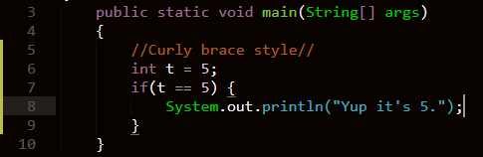
Inline curly brace style
Unless you’re working on a team project for boss with a certain “style mandate” this shouldn’t matter.

Slide 6
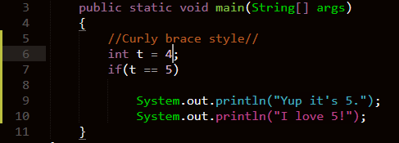
Single – line, no curly braces
I love 5!, will always print, regardless of t’s value. Which might not be your intention as a programmer.

Slide 7
More about the code (con.)
“Always” (Except what I said earlier) enclose your if statements with an opening curly brace “{“ and a closing curly brace “}”.
The line where you start an if statement, if(<boolean expression>), should not be ended with a semicolon “;”.
Spoiler alert : The above will be true for all conditionals, loops, and functions.
If t hadn’t equaled 5, the code would have just continued to execute past the closing curly brace.

Slide 8
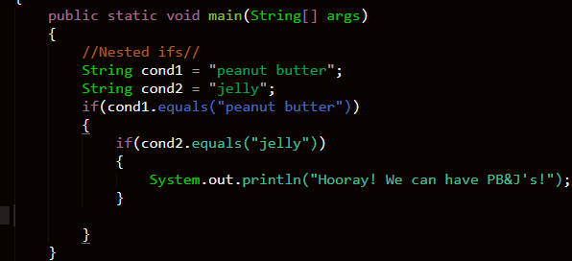
Nested ifs
Don’t mind .equals() for now, Strings are objects and therefore a weirdness to deal with later. (.equals() is basically a “==“ for objects).
Nested ifs can be avoided, most of the time
You may be thinking, hmmm… if this ANDDDDD if that, then do a thing. Could we do this easier?

Slide 9
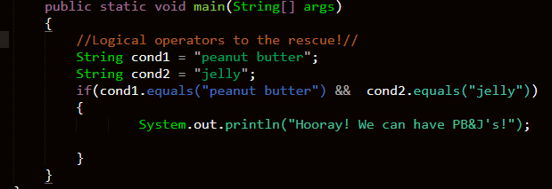
“Nested ifs” the better way
Logical operators to the rescue!
This works exactly the same way as the previous code, but is way easier to maintain and read.

Slide 10
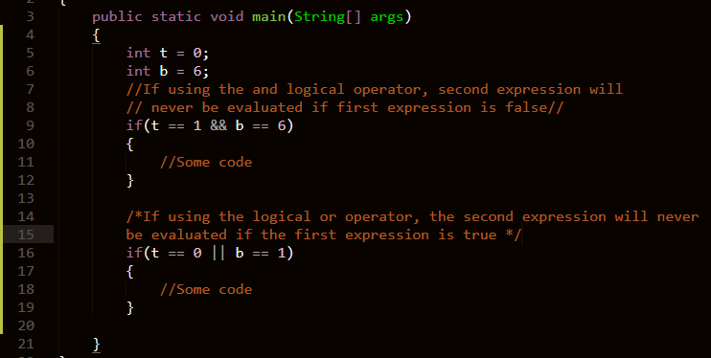
Short-circuit evaluation with logical operators

Slide 11
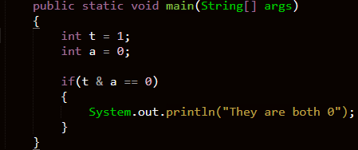
A warning with if’s and logical operators
You’ll inevitably write this piece of code to save writing, don’t it won’t work the way you think it’s supposed to.
First off, the operator is (&&) or (||), doing a single version of those don’t do the operation you are looking for.
Second, logical operators work with boolean values, meaning each side of the logical operator should have a boolean expression, not just a number.

Slide 12
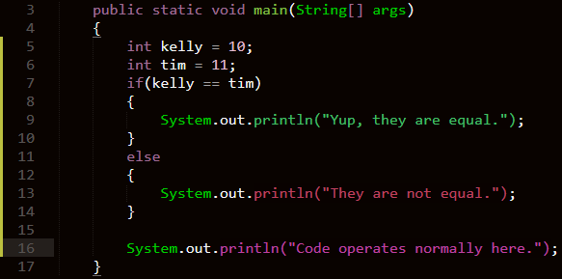
If else
Forces the computer to make a choice, is a condition is valid do the first thing, but if it’s not do the second thing.
There’s also an incredibly ugly style note to point out here, but I’ll put a pic of that on the next page.

Slide 13
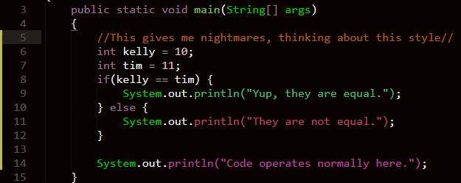
The ugliest looking thing in coding.
Again, this is up to your preference to follow or not if you only plan to work alone.

Slide 14
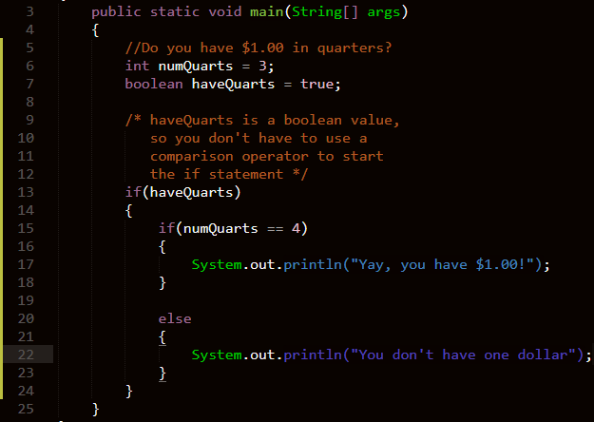
Nesting if else’s in ifs
Generally, nesting if else’s inside an if is an easier way to think about things instead of using logical operators.

Slide 15
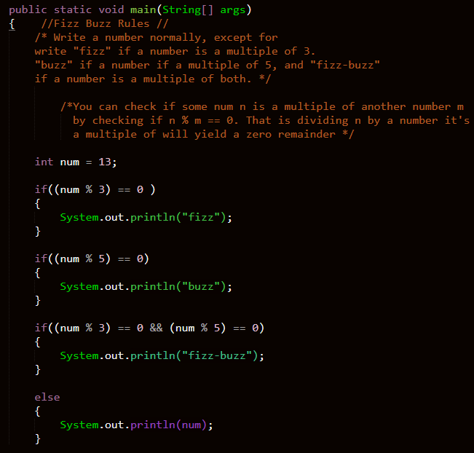
Another path
You might be wondering, gee if-else makes code go down one of two different paths.
Is there a way to add more paths?
YES!
Is multiple if’s before an else the way?
NO!
(PS: There is a closing curly brace in
the code, it just couldn’t fit in the
screenshot)

Slide 16
Problems with the code
The else will ALWAYS execute, as long as the number isn’t a multiple of 3 and 5.
This is because else’s (without special trick) have “adjacent associativity” that is they’re only an else clause on the if that is closest to itself.
If a number is a multiple of 3 and 5, “fizz”, “buzz”, and “fizz-buzz” will print.
This is because you as programmer said “if this is true, do a thing then execute code past the curly brace”.
If only there was a way to fix the madness!

Slide 17
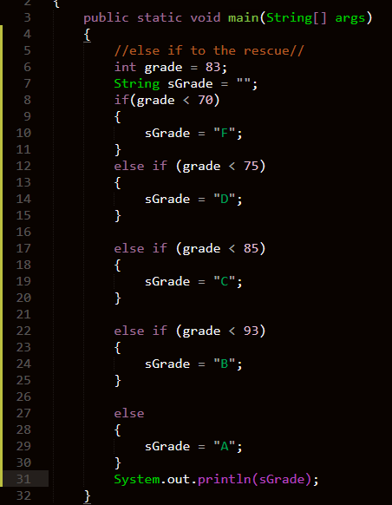
Else if

Slide 18
Beware the else if
Be very careful when using the else if.
To reference the code from the last slide, after the first if(grade < 70), if any condition occurs asking about a number lower than 70, they will be ignored.
Think of it this way: else if’s only get reached if the previous conditions were NOT met.
Therefore, rewriting the fizz-buzz code as is just switching any if’s after the first one to an else if won’t work. If a number is not a multiple of 3 or 5, it couldn’t possibly be a multiple of 3 and 5.
(Proper rewrite on next page).
Also, there’s ugly style conventions similar to the else for else if, but again, pish-posh it looks awfully ugly.

Slide 19
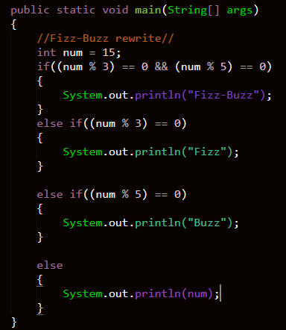
Fizz-Buzz Rewrite

Slide 20
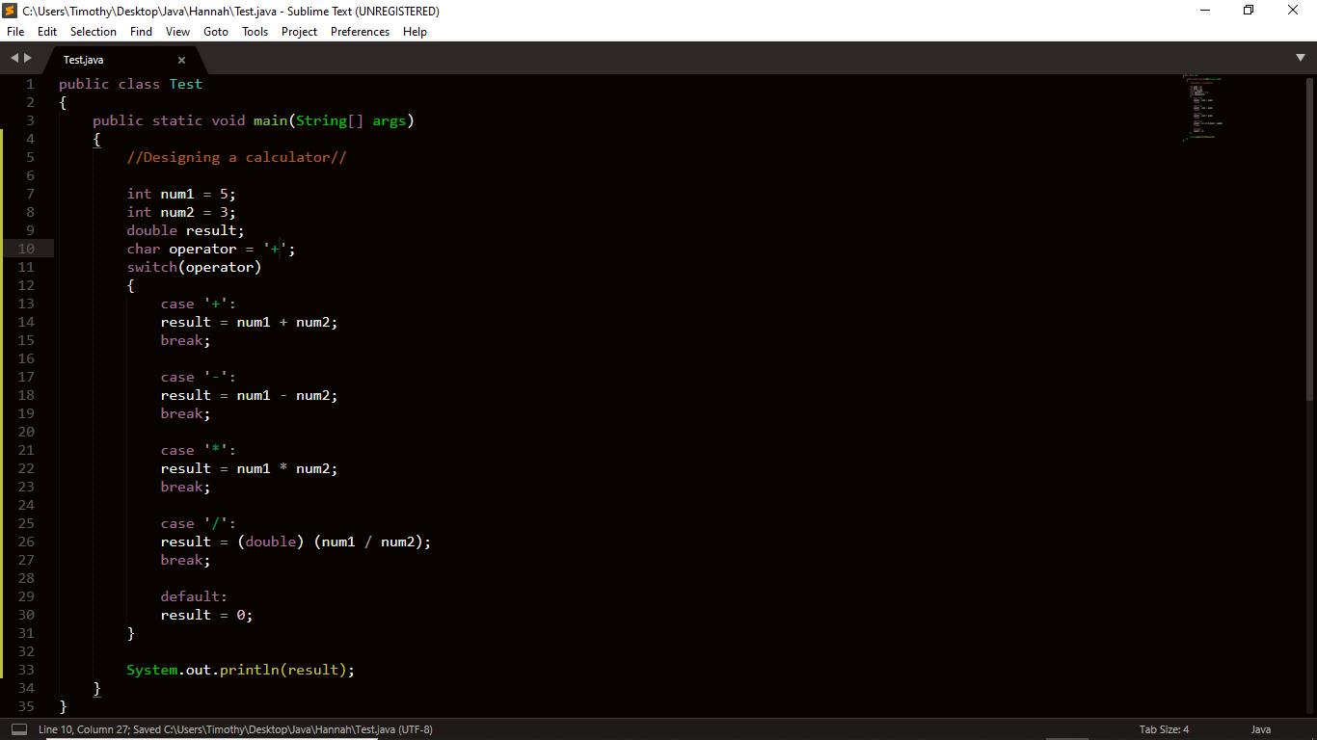
Switch statement
If you find yourself checking for equivalence against a bunch of different cases, a switch statement might be better that a boat load of else ifs.

Slide 21
Explaining switch
The value in the parentheses of the switch is the value all the “case’s” are being compared against for equality.
case testValue: , is an implicit way of saying if(value == testValue), then do a thing.
You can put as much code as you under a case without curly braces.
The breaks at the end of each case tells the computer to skip to the end if you find what you’re looking for.
The default line only executes if no equivalence is found.

Slide 22
Loops

Slide 23
Loops (AKA: Iteration)
Iteration – The repeating of a process
Types:
1. for loops
2. nested for loops
3. while loops
4. do-while loops

Slide 24
For loops
Repeat a certain piece of code a certain number of times that the coder generally knows ahead of time.
for(<initialize>; <boolean expression>; <increment/decrement>)
{
//Some code//
}
The line you declare a for loop on should not end with a semicolon.
The code of a for loop should be enclosed between a { and }.
The initialize portion generally looks like: int i = 0;.
This is called a counter variable and is generally used to keep track of how many times the loop executes.
Counter variables, by “tradition” are generally named i, j, k…
These names are to emphasize the fact that counter variables should not be used outside of the for loop.

Slide 25
For loops (cont.)
for(<initialize>; <boolean expression>; <increment/decrement>)
{
//Some code//
}
The boolean expression is the condition the loop must past every time in order to run. If the boolean expression evaluates to false, the for loop stops and code executes past the loop.
The increment/decrement is what you want to happen to the counter variable after every pass through your code.

Slide 26
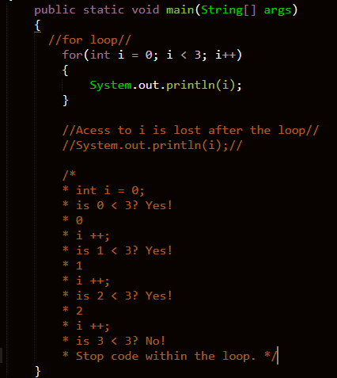
For loops example

Slide 27
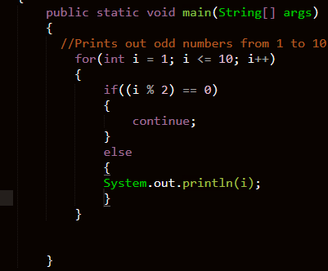
Continue
If you want to skip a certain iteration of a for loop, continue is your new best friend.

Slide 28
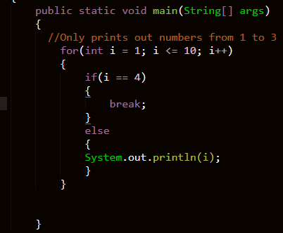
Break
Gives you a way to immediately exit from a loop if a certain condition happens.

Slide 29
Nested for loops
For(int I = 0; I <= 10; I ++)
{
For(int j = 0; j <= 10; j ++)
{
System.out.println(“*”);
}
}
The outer for loop runs 10 times, and the inner for loop runs 10 times for every 1 run of the outer for loop, so this will print “*” 100 times.
The intuition is, the inner loop runs all of its iterations every time the outer for loop runs 1 iteration.

Slide 30
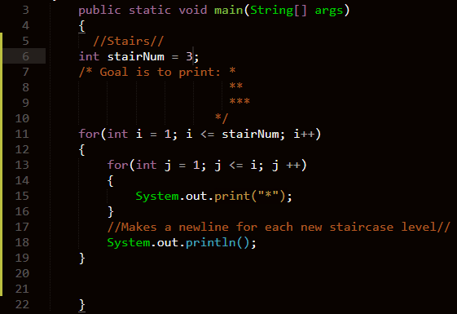
Stair example

Slide 31
While loops
<initialize>;
while(<boolean expression>)
{
//Some code//
<increment/decrement>;
}
All of these parts work the same way they worked with a for loop, except the initialization of a counter variable happens outside of the while loop.
Continue and break work the same way they worked in a for loop.
While loops are best used when the number of iterations you need to happen is unknown.

Slide 32
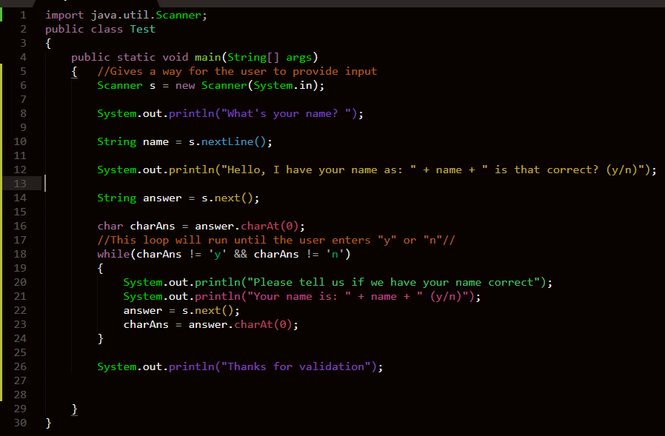
Input validation (While loop example)
Input validation is the concept of prompting the user for input then if they provide bad input, they’re put in an infinite loop of which they can’t exit until they provide proper input.
Again, don’t worry about all the String and scanner stuff, that’ll come later.

Slide 33
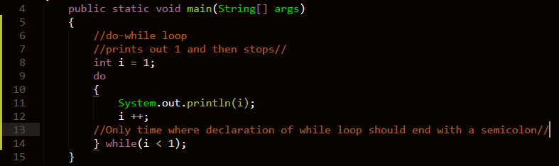
Do while loop
A while loop’s weird cousin, that does the loop’s first pass through automatically, and then checks if the condition is valid

Slide 34
Functions

Slide 35
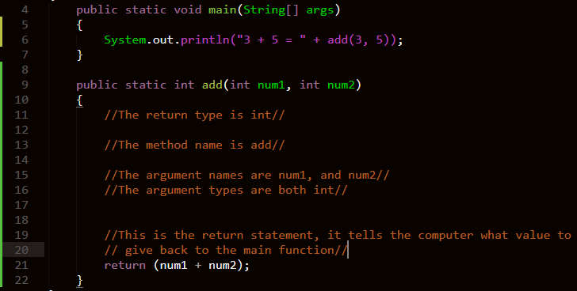
Functions
Called static methods in Java (why this is exactly to be explained more later).
Pauses execution in the main function (the caller) and runs the function that was called (calle) to completion.
Are a way to keep you from repeating yourself and making the same few bits of code be wrapped up in a function
Functions have a:
Return type
Method name
Argument type
Argument name
And a return statement

Slide 36
Return types
Possible return types include any of the primitive types discussed previously.
Objects can also be returned too.
If you want to cause a side effect that is not return a value but instead “do something”, the proper return type would be void.
Functions can have more than one return statement, but can only return one value.
Even in void functions, you can use the return keyword as a “defacto” break statement.

Slide 37
“Calling a function”
A function call generally looks like this: funcName(argType1 arg1, argType2 arg2, …);
This means, go to whatever this function is called in the code, and consider that function’s arguments to be equal to the value of the arguments you put in the parentheses.
Arguments in functions are passed by value, meaning anything you do the arguments within the function, will not change the value of the variables you passed in.
//See swap example on next page//

Slide 38
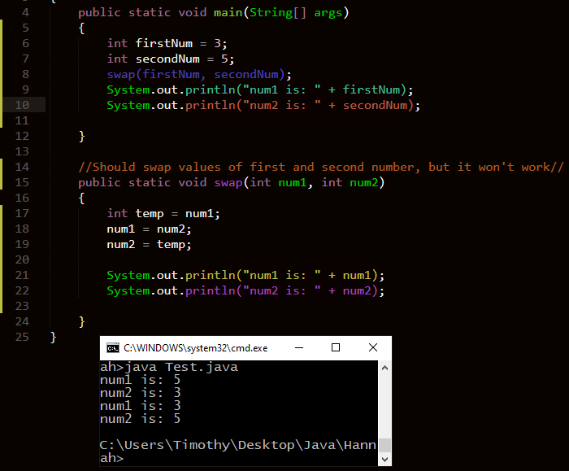
Swap example
You’d have to swap firstNum and secondNum outside of a function for it to work properly

Slide 39
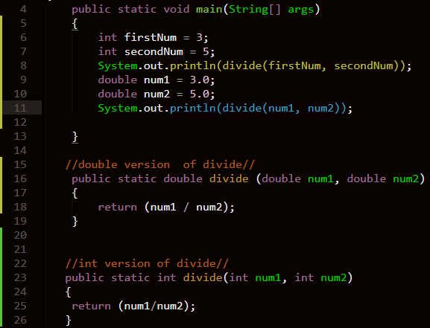
Method overloading
Method overloading is using the same name for a function more than once as long as the argument types differ.

Slide 40
Next time
More about functions:
Variable scope
Recursion
The pesky keyword “this”
User Input

